Slide 1
Enterprise Security Management
Network Security Day 3

Slide 2
Class Objectives
By the end of class, you will be able to:
Analyze indicators of attack for persistent threats.
Use enterprise security management to expand an investigation.
Use OSSEC endpoint reporting agents as part of a host-based IDS alert system.
Investigate threats using various analysis tools.
Escalate alerts to senior incident handlers.
2

Slide 3

Before we get started, we need to launch an instance of Security Onion.
This will generate alert data that will be used to complete the labs.
3
Notes:
Image source: shutterstock_1083618569

Slide 4
Activity: Security Onion Setup
Follow along as we set up Security Onion and generate alert data.
10 Minutes
4

Slide 5

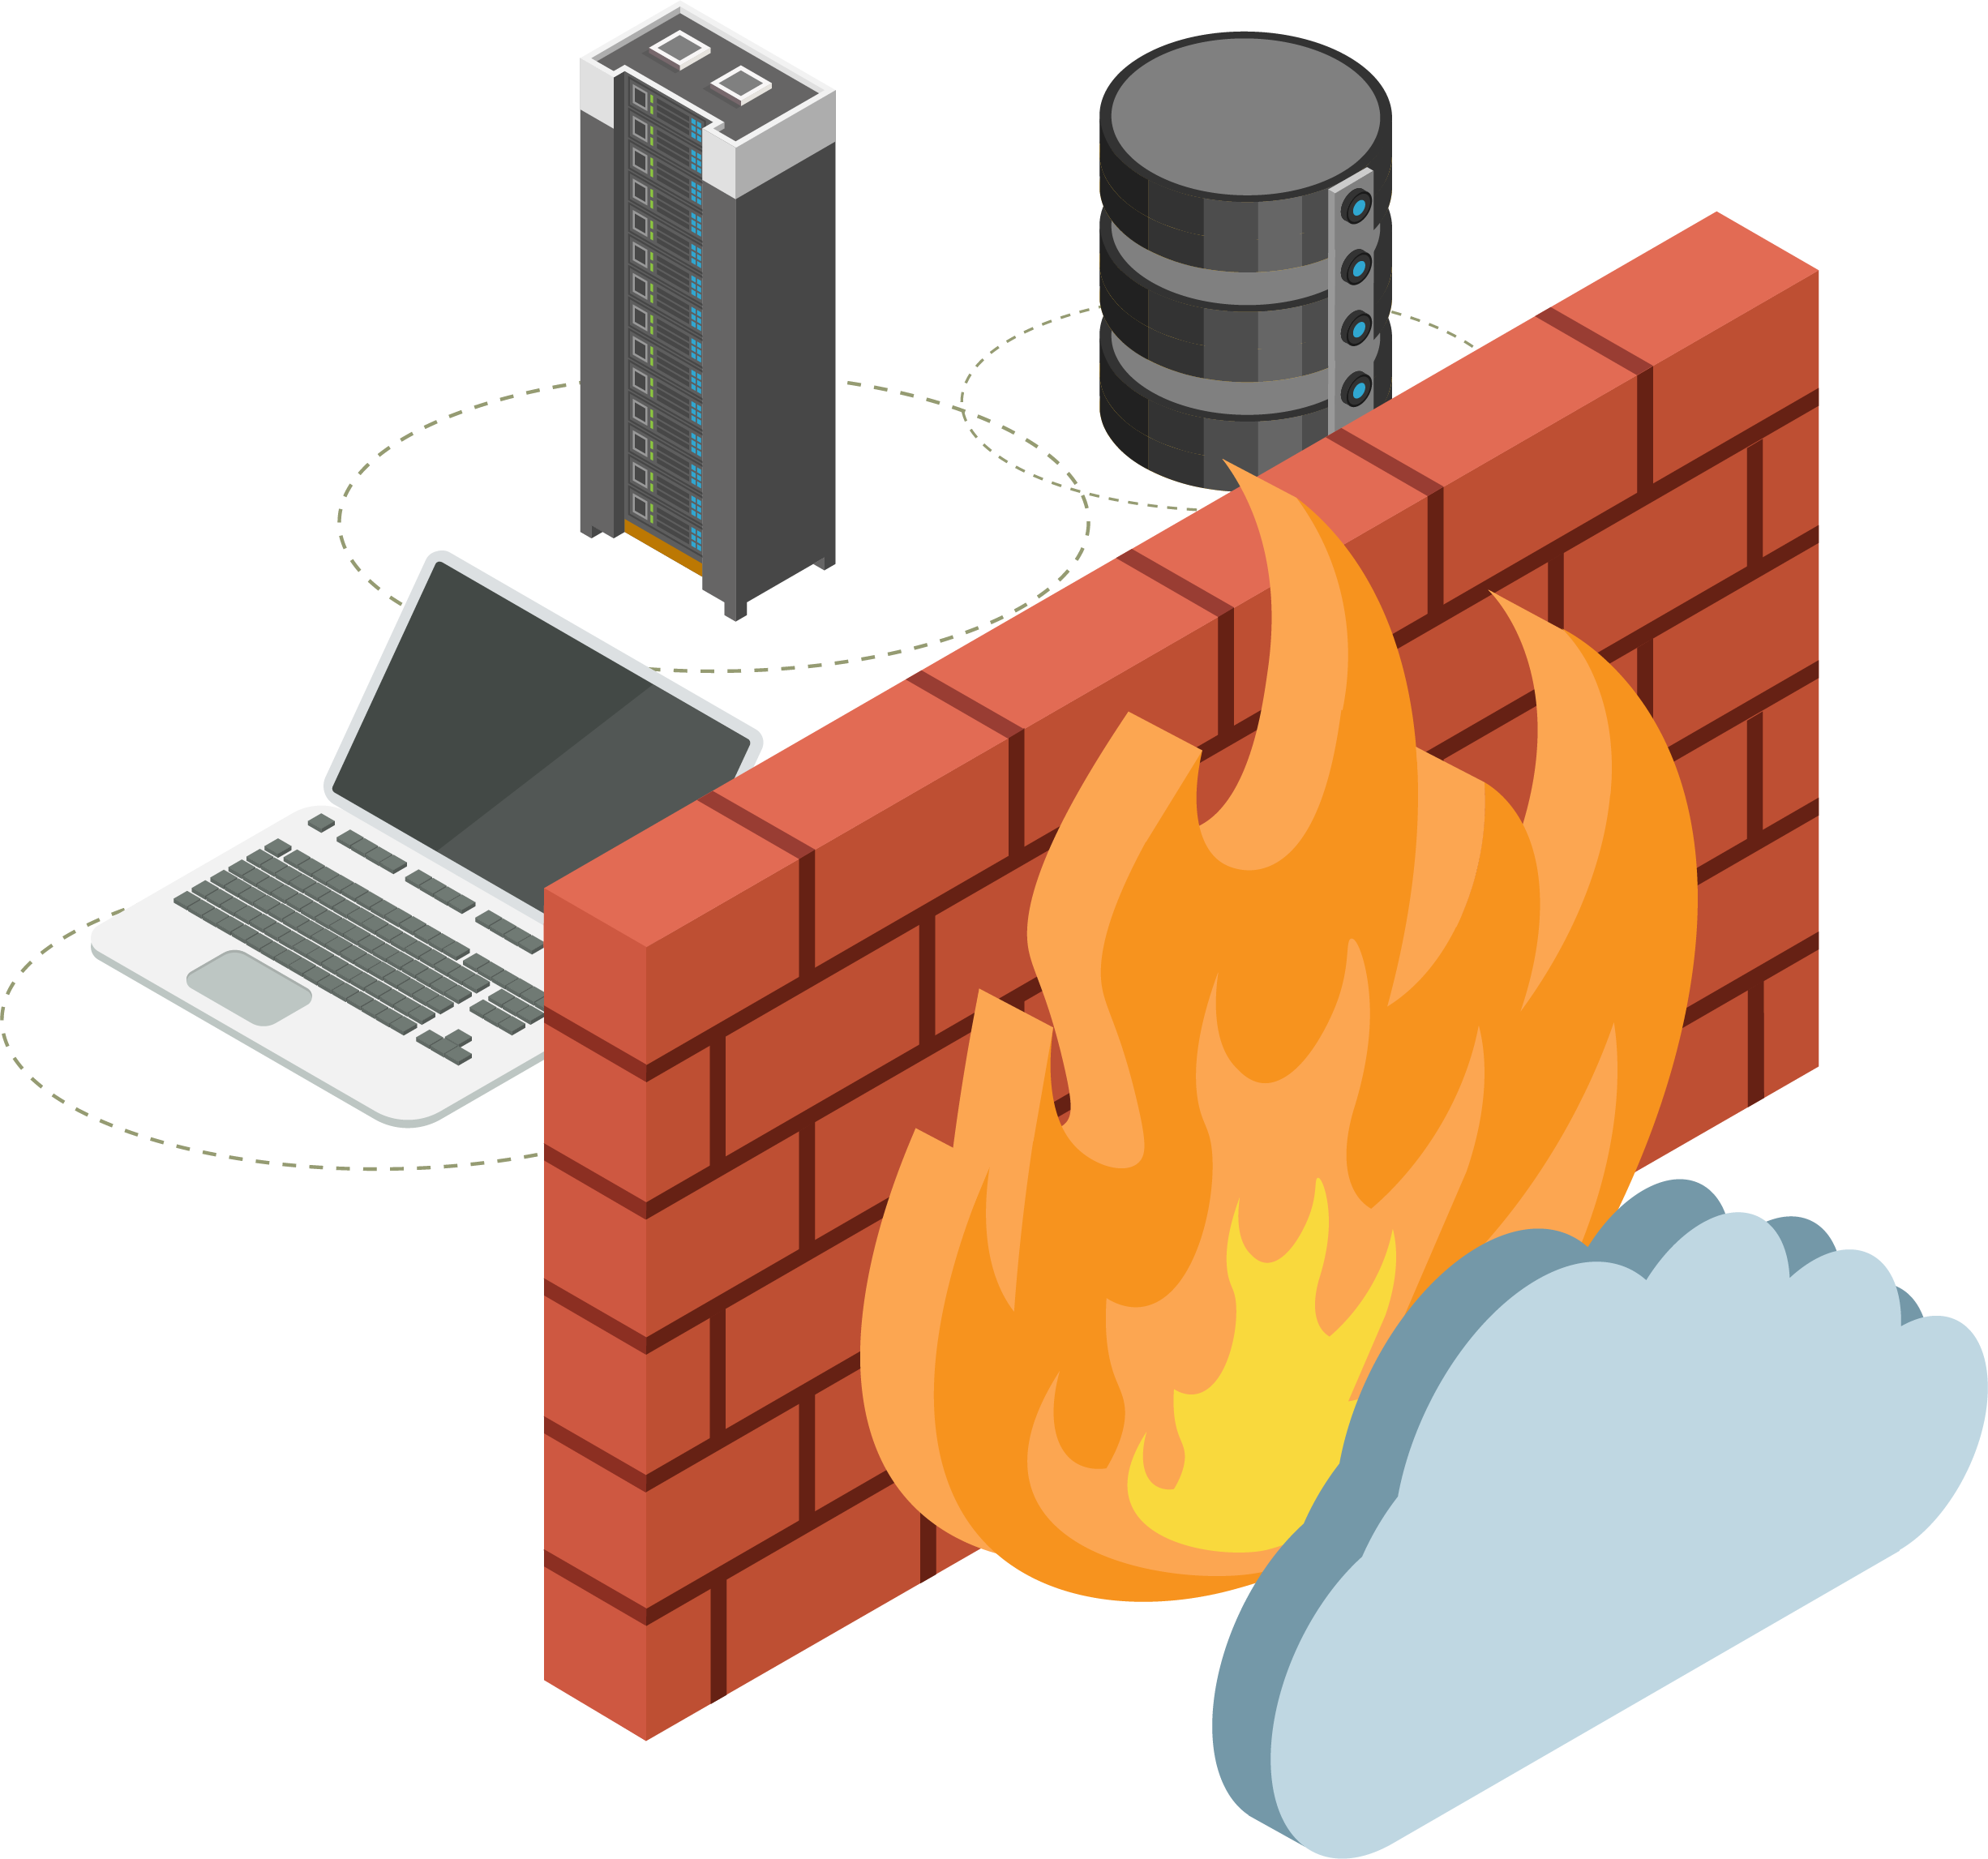
Firewall Recap
Firewalls protect networks by making decisions based on rules. Firewalls are designed to allow traffic from trusted sources and block traffic from untrusted sources.
Firewalls do have limitations. They can be easily fooled through packet manipulation by clever hackers.
For example, attackers can send malicious data through a firewall by hijacking or impersonating a trusted machine.
This is why it's crucial to have an effective defense in depth methodology to help protect sensitive data.
5
Notes:
shutterstock_792833623

Slide 6
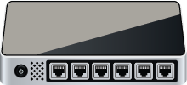




IDS Recap
An IDS is like a firewall that reads the data in the packets it inspects, issues alerts, and blocks malicious traffic (if configured to do so).
IDS
LAN
Host 1
Internet
Host 2
Switch
Router
6
Notes:
LAN and Laptops: AdobeStock_41735567 Router: shutterstock_263070023 Firewall: shutterstock_1214853796 Cloud: AdobeStock_184417876

Slide 7

IDS Recap
There are many varieties of intrusion detection systems, but today’s class will focus on Snort, the world’s most popular open-source solution.
Network security monitoring (NSM) is the process of identifying weaknesses in a network’s defense.
It also provides organizations with situational awareness of their network.
7

Slide 8
Alert: C2 Beacon
8

Slide 9
C2
In the next activity, we will apply our knowledge of NSM to an attack that targets a Command and Control (C2) server.
9
Notes:
shutterstock_645542983

Slide 10
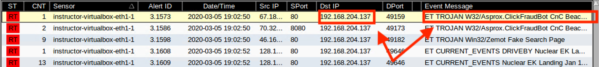
Command and Control (C2)
C2 servers are used to create a specific type of alert for attacks that use persistence as part of its attack campaign.
Infected hosts make callbacks to C2 servers.
These callbacks (referred to as "keep alives") serve as beacons that keep the back channel open to enable access in and out of the network at all times.
Alert identified as a C2 beacon acknowledgement
10

Slide 11
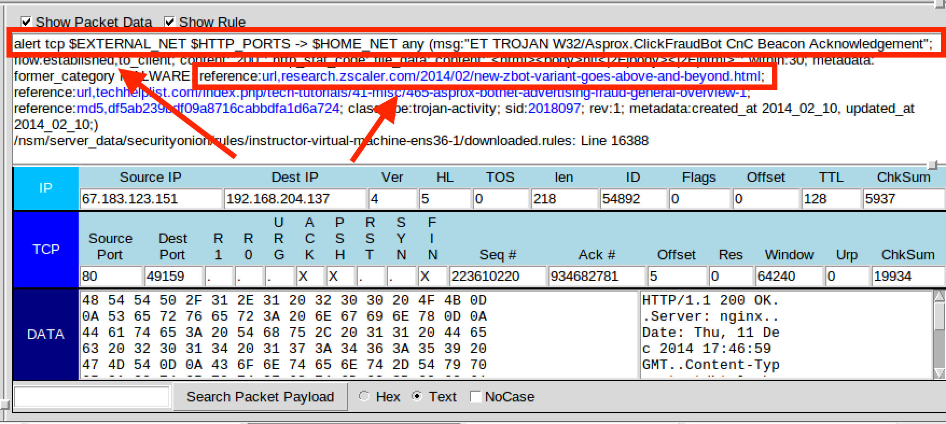
Command and Control (C2)
Writers of Snort rules can include a reference URL in the Snort rule option.
Snort rules can include links to help network defenders establish TTPs regarding their attackers.
With this information, network defenders can form mitigation strategies to help improve their security posture.
11

Slide 12
Activity: C2 Beacon
In this activity, you will establish an attacker profile that includes the TTPs
used by the adversary in an emerging threat: a C2 beacon acknowledgement.
20 Minutes
12

Slide 13
13

Slide 14
Now that we’ve learned about the benefits of using firewalls and NSM, we’ll cover the more all-encompassing enterprise security monitoring (ESM), which includes endpoint telemetry.
14
Notes:
Image source: shutterstock_1083618569

Slide 15

OSSEC
Remember that firewalls and NSMs
cannot see inside encrypted traffic.
In most cases, malware will be transmitted from attacker to victim in an encrypted state to hide its presence and intent. This also serves as a method of obfuscation to bypass IDS detection engines.
Malware cannot activate in the encrypted state. It must be decrypted before it can launch. This can only happen after it’s been installed on the victim’s machine.
This is where ESM and, more specifically, endpoint telemetry become relevant.
Notes:
shutterstock_1127482970

Slide 16


OSSEC
ESMs use OSSEC to provide visibility at the host-level, where malware infection takes place after it's decrypted.
OSSEC is the industry’s most widely used host-based IDS (HIDS).
It has many configuration options and can be tailored to the needs of any organization.
16
Notes:
AdobeStock_295428334

Slide 17

Endpoint telemetry is essentially host-based monitoring of system data.
17

Slide 18


OSSEC
OSSEC agents are deployed to hosts and collect syslog data.
This data generates alerts that are sent to the centralized server, Security Onion.
Security administrators can then use Security Onion to form a detailed understanding of the situation and reconstruct a crime.
18
Notes:
shutterstock_723768979

Slide 19

Elastic Stack
OSSEC monitors syslog data, but security admins use three other important tools to fully analyze packet captures.
(elastic.co)
19

Slide 20


Elastic Stack
These tools are collectively known as Elastic (ELK) Stack, the engine that operates within Security Onion.
The heart of Elastic Stack, a distributed, restful search and analytics engine capable of addressing thousands of data points seen within network traffic.
Helps security administrators located the expected and uncover the unexpected.
Open-source, server-side data processing pipeline built into Security Onion.
Ingests data from many sources at the same time by transforming it and sending it to designated log files, referred to as stashes.
A browser-based visualization interface. It uses thousands of data points from the Elastic Stack as its core engine.
20

Slide 21






Elastic Stack
OSSEC agents
OSSEC server
Web browser
Queries
Logs
Alerts via syslog
Log data
Log results
21

Slide 22
Elastic Stack
01
OSSEC generates an alert.
02
OSSEC sends alert data gathered from syslog to Security Onion’s OSSEC server.
03
The OSSEC-generated syslog alert is written to Logstash for storage.
Log data is ingested into the Elasticsearch analytics engine, which parses hundreds of thousands of data points to prepare for data presentation.
04
Users interact with data through the Kibana’s web interface.
05

Slide 23
We will use the ESM tools Squert and Kibana to investigate a network security breach.
23
Notes:
Image source: shutterstock_1083618569

Slide 24
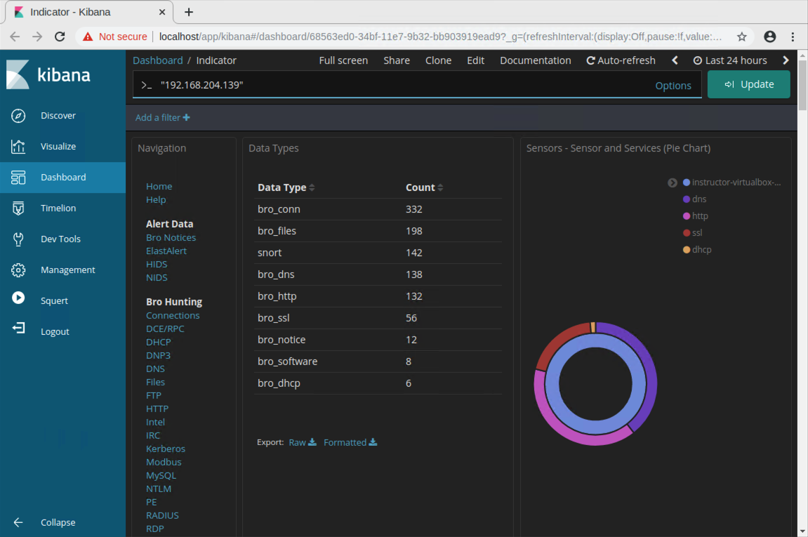
Investigation, Analysis, and Escalation Demo
We’ll be acting as a junior analyst working in a Security Operations Center.
Junior analysts belong to a multi-tier group of analysts.
Junior analysts typically perform the initial triage of alerts and then escalate these events to senior incident responders.
24

Slide 25
Investigation, Analysis, and Escalation
25

Slide 26
Demonstration Recap
In this demonstration, we conducted investigations using various threat hunting techniques. We focused on only a few of the many ways to start an investigation.
01
02
03
Enterprise security monitoring (ESM) includes endpoint telemetry, host-based monitoring of system data that uses OSSEC collection agents to gather syslog data.
To investigate network-based IDS alerts, security administrators must use enterprise security monitoring, which includes visibility into endpoint OSSEC agents.
IDS alerts are snapshots in time. They raise questions that need answers. With the use of Security Onion, security admins can use PCAPs to reconstruct a crime.
26

Slide 27
Activity: Investigation, Analysis, and Escalation
In this activity, you will use Squert and Kibana
to investigate, analyze, and escalate indicators
of attack.
20 Minutes
27

Slide 28
28

Slide 29


Notes:
Image source: AdobeStock_56885471

Slide 30
BLUE TEAM DOCTRINE
30

Slide 31
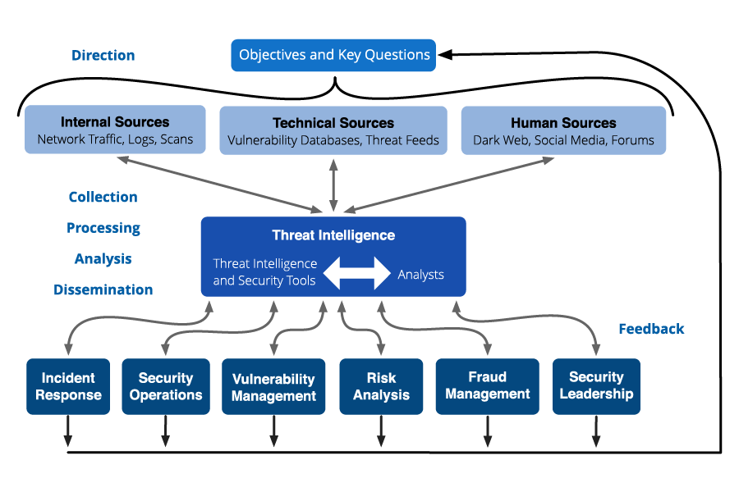

Slide 33
Threat intelligence is important at every level of government and public sector organizations, which use it to determine acceptable risk and develop security controls that inform budgets.
33
Notes:
Image source: shutterstock_1083618569

Slide 34

Threat Intelligence: Know Thy Enemy
Understanding what motivates attacks against your organization will help you determine the security measures necessary to defend against them.
01
Hacktivist organizations are politically motivated.
02
Criminal hackers are are financially motivated.
03
Cyber espionage campaigns, typically associated with nation states, steal corporate secrets.
34
Notes:
shutterstock_1085385533

Slide 35
Computer and Incident and Response Teams (CIRT), are responsible for establishing threat intelligence cards, which document the TTPs used by adversaries to infiltrate a network.
35

Slide 36

Threat Intelligence Card
When handling a large-scale intrusion, incident responders often struggle to organize intelligence-gathering efforts.
Threat intelligence cards are shared among the cyber defense community, allowing organizations to benefit from the lessons learned by others.
The triad of actors, capability, and intent informs situationally aware decision making, enhanced network defense operations, and effective tactical assessments.
1
Actors
2
Capability
3
Intent
THREAT
36

Slide 37
APPLIED INTELLIGENCE OPERATIONS “THREAT HUNTERS”

Slide 38

WHAT THREAT HUNTING ISN’T
FAIL ARMY THREAT HUNTING
- INCIDENT RESPONDING:
“if you’re responding you probably
aren’t hunting.”
- Reconstructive over Pre-constructive
thesis.
- Only applying what you’ve learned
after an adverse event opposed to
before.

Slide 39

REAL THREAT HUNTING
OBJECTIVES
- Actively searching for security gaps
- Evaluating IOC(S)
- Collecting TTP(S)
- Refining Threat Intelligence/ Hunt Data
- Performing intrusion discovery
- Devising increasingly attacker
hostile/hunter friendly environments
for continued operations.

Slide 40

FAQ: So…what do you mean “Attack hostile environment?”

Slide 41
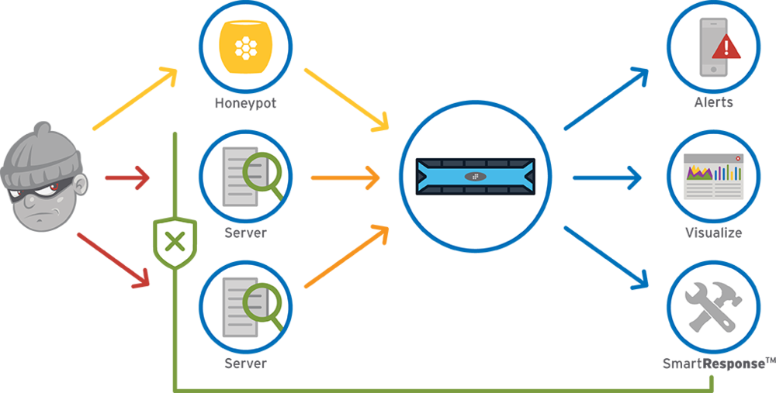
THREAT HUNTER’S PERSPECTIVE

Slide 42


ATTACKER’S PERSPECTIVE

Slide 43
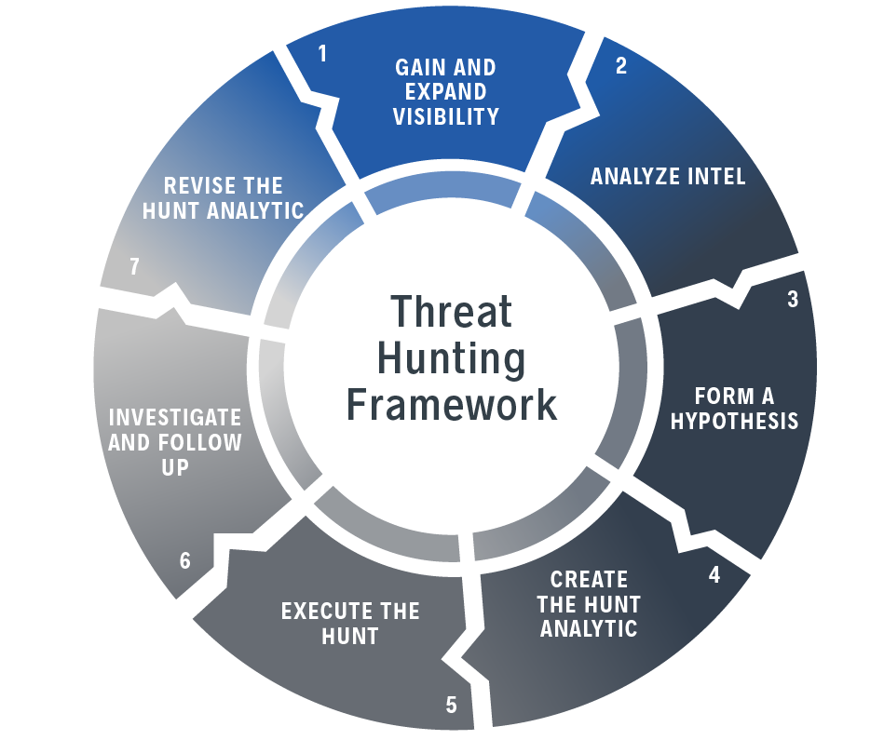
Good Threat Hunting Is Intelligence Driven!
A seasoned hunter knows that the ability
to create accurate theses, recognize stages
of the cyber-kill-chain and indicators of
compromise/attack are essential to a
successful hunt.
“Your hands can’t hit what your eyes
can’t see.” - Cassius Clay

Slide 44
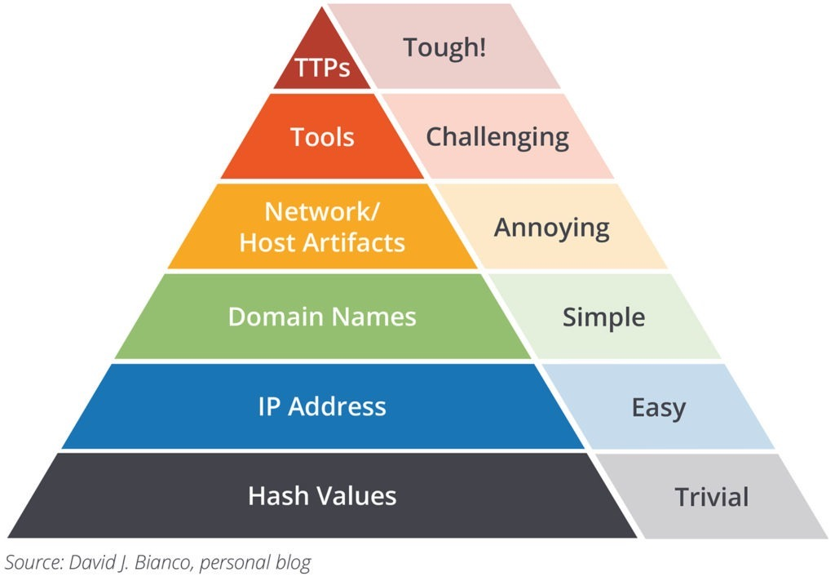

“PYRAMID OF PAIN”
HACKERS BE LIKE

Slide 45

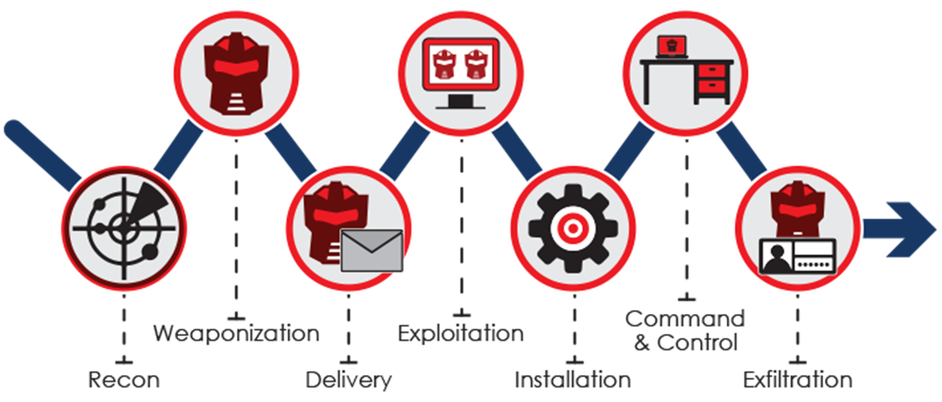
Data Domain
Network
Host
Application
PCAP
Flows
Proxies
DNS
System:
Events
Files
Autoruns
Logs:
DB
AuthN
Alerts
Cyber “Unalive” Chain

Slide 46
Activity: Investigation Analysis Escalation
In this activity, you will strengthen your knowledge of concepts related to intelligence gathering and incidence response as part of the ESM process.
Use any tool you've learned to hunt for a malicious threat and create a threat intelligence card.
45 Minutes
46

Slide 47
47

Slide 48
Questions?
48

Slide 49
Unit 12 Personal Azure Accounts
For the upcoming Cloud Security and Project Week units, you will need your own individual Azure accounts. You will not be using the cyberxsecurity accounts
Refer to the following guide:
Personal Azure Account Set Up Guide

Slide 50
50

